Slide 1
Lesson 3
Computer Basics

Slide 2
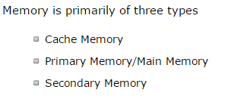

Slide 3
Cache memory is a very high speed semiconductor memory which can speed up CPU. It acts as a buffer between the CPU and main memory. It is used to hold those parts of data and program which are most frequently used by CPU. The parts of data and programs are transferred from disk to cache memory by operating system, from where CPU can access them.

Slide 4
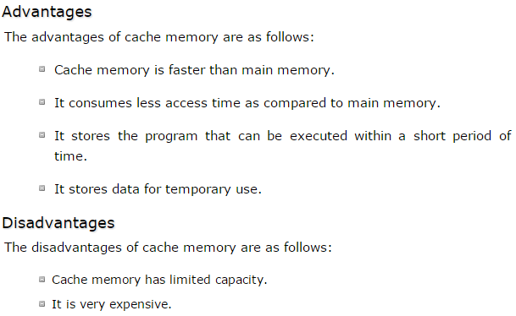

Slide 5
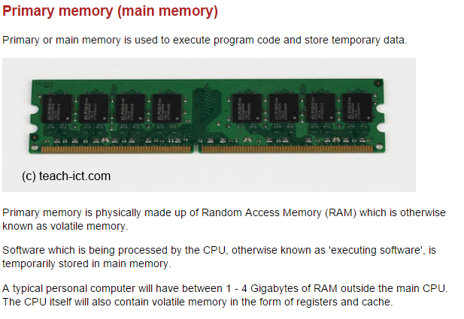

Slide 6
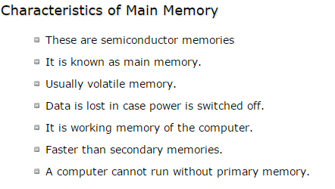
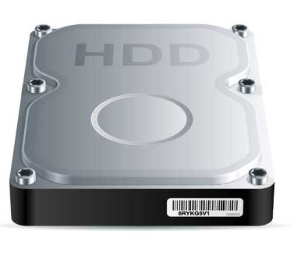

Slide 7
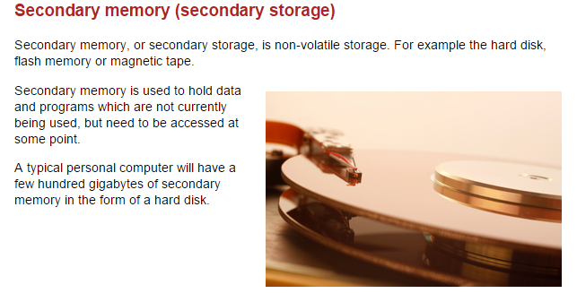

Slide 8
